Slide 1

Blinkit Business Performance Analysis
A SQL-Based Project on 3.85 Million Retail Transactions
Team Name :- Vertex

Slide 2
CONTENTS
1
4
Dataset Statistics
Code Snippet
2
5
Problem Statement
Our Insights
3
6
Expected Business Impact
Problems Faced By Us

Slide 3
Dataset Link
3.85 M+
Over 3.85 million order records analyzed.
37
More than 743k unique customer IDs.
743 k+
37 attributes covering orders, customers, stores, payments, and deliveries.
37
5 Yrs
Transaction data spanning 2022–2026.
Orders fulfilled through 142 dark stores across multiple cities.
142

Slide 4
Problem Statement
Project Objectives
Blinkit processes millions of customer orders every year, making it difficult derive meaningful business insights directly from raw transactional data. This project focuses on analyzing over 3.85 million order records to identify revenue trends, customer purchasing behavior, operational performance, payment preferences, and growth opportunities
To analyze Blinkit's order data from 2022 to 2026 using MySQL and generate actionable business insights related to revenue, customer behavior, payment trends, delivery performance, and business growth. The project aims to demonstrate how SQL can transform large- scale transactional data into meaningful insights that support data-driven decision-making.

Slide 5
Identify top revenue-generating cities
Track yearly and monthly GMV trends.
Focus investments on high-performing regions.
Identify peak ordering hours
Reduce cancellations and returns.
. Monitor store-wise delivery performance.
Revenue Optimization
Operational Efficiency
Customer Experience
Payment & Promotions
Understand customer purchasing behaviour.
Increase repeat customer retention.
Identify high-value customer segments.
Analyze payment preferences.
Measure UPI adoption trends.
Evaluate the effectiveness of discounts and promo campaigns.

Slide 6
Business Impact
1. Data Overview
Total orders and dataset coverage
Year-wise GMV growth
Order status distribution
Delivery success rate
2. Revenue & Geography
Top revenue-generating cities
Best and worst performing dark stores
High-demand pincode areas
Average Order Value (AOV) by location
3. Time-Based Analysis
Peak ordering hours
Weekday vs Weekend demand
Monthly GMV trends
Festive season spikes
4. Customer Behaviour
Payment method preferences
Platform usage (Android, iOS, Web)
User tier comparison
Repeat vs First-time customers
Top lifetime customers
5. Promotions & Discounts
Most used promo codes
Discount analysis
Cashback impact
GMV lost due to promotions
6. Operations & Growth
Cancellation & return reasons
Delivery performance
Month-over-month GMV growth
Business growth opportunities

Slide 7
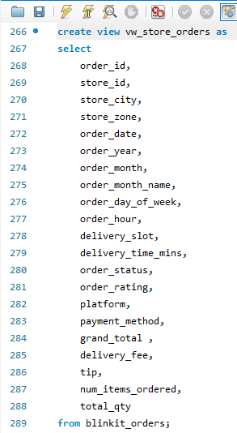
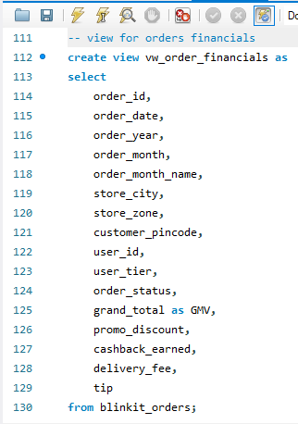
Why We Created Views
Reduce repetitive SQL code
Improve query readability.
Simplify business analysis.
Organize data into logical domains.
Support faster report
development.

Slide 8
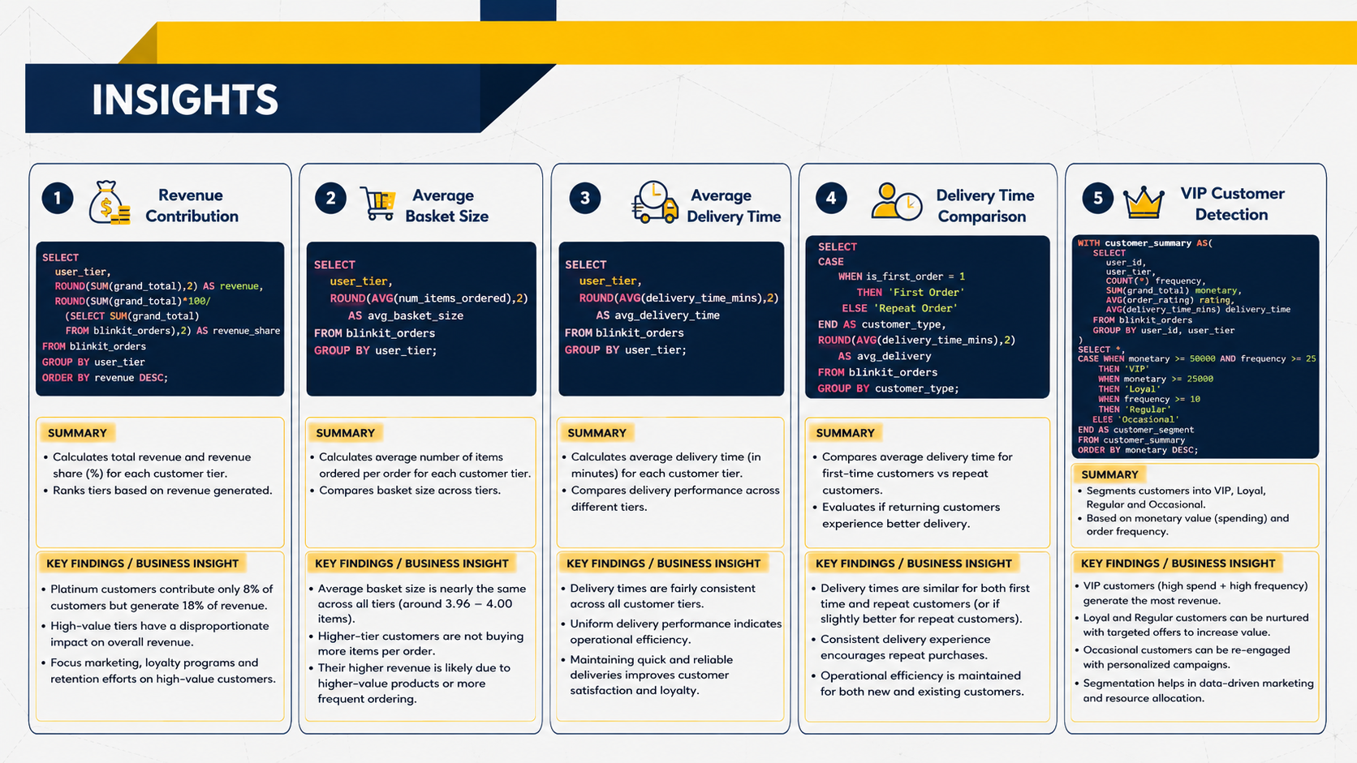

Slide 9
Problems faced by us
The BlinKit dataset consists of over 3.8 million rows; while importing it, we experienced a delay of over 4–5 hours.
Normalization make dataset harder to analyze because there is only one unique id in table which is order_id.
Connection lost during MYSQL query while applying Indexes and running query.
Due to large dataset we were unable to run query efficiently even after adding indexes on them .

Slide 10
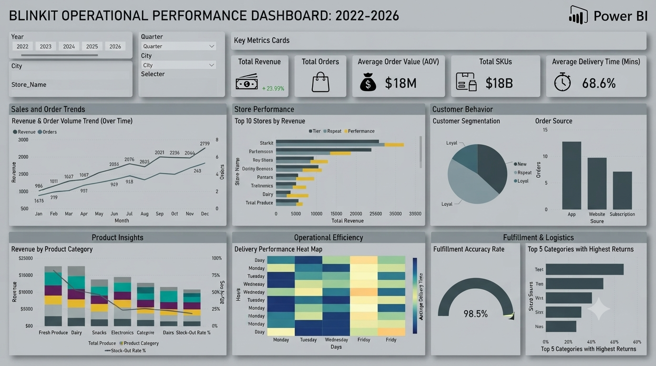
Future Scopes

Slide 11
THANK YOU

